Slide 1
Gradient Boosted Decision Trees (GBDT)
D.UTHRADEVI
(19PITE18)

Slide 2
Do you know about Decision Tree algorithm?

Slide 3
01
Decision Trees
Synopsis
02
Gradient Boosted Decision Trees (GBDT)
03
How it works?
04
Real time problems.

Slide 4

AWESOME
Decision Tree
A decision tree is a simple representation for classifying examples. Decision tree learning is one of the most successful techniques for supervised classification learning. For this section, assume that all of the features have finite discrete domains, and there is a single target feature called the classification. Each element of the domain of the classification is called a class.
A decision tree or a classification tree is a tree in which each internal (non-leaf) node is labeled with an input feature. The arcs coming from a node labeled with a feature are labeled with each of the possible values of the feature. Each leaf of the tree is labeled with a class or a probability distribution over the classes.
To classify an example, filter it down the tree, as follows. For each feature encountered in the tree, the arc corresponding to the value of the example for that feature is followed. When a leaf is reached, the classification corresponding to that leaf is returned.

Slide 5

Gradient Boosted Decision Trees (GBDT)
GBDT is an ensemble algorithm which uses boosting method to combine individual decision trees.
Boosting means combining a learning algorithm in series to achieve a strong learner from many sequentially connected weak learners. In case of GBDT, the weak learners are decision trees.
Each tree attempts to minimize the errors of previous tree. Trees in boosting are weak learners but adding many trees in series and each focusing on the errors from previous one make boosting a highly efficient and accurate model. Unlike bagging, boosting does not involve bootstrap sampling.
Every time a new tree is added, it fits on a modified version of initial dataset.

Slide 6
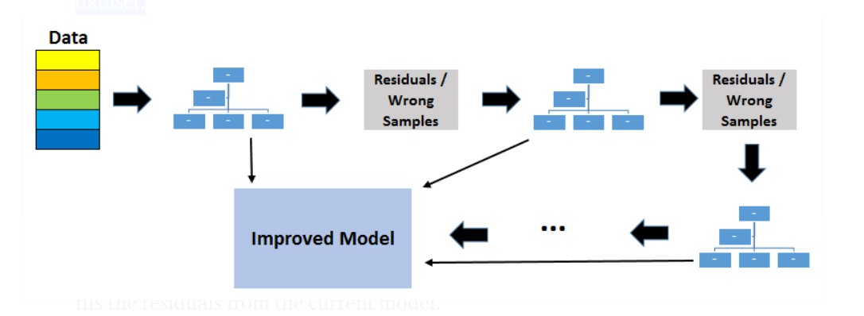
Since trees are added sequentially, boosting algorithms learn slowly. In statistical learning, models that learn slowly perform better.
A loss function is used to detect the residuals. For instance, mean squared error (MSE) can be used for a regression task and logarithmic loss (log loss) can be used for classification tasks. It is worth noting that existing trees in the model do not change when a new tree is added. The added decision tree fits the residuals from the current model.
Learning rate and n-estimators are two critical hyperparameters for gradient boosting decision trees. Learning rate, denoted as α, simply means how fast the model learns. Each new tree modifies the overall model. The magnitude of the modification is controlled by learning rate. N-estimator is the number of trees used in the model. If the learning rate is low, we need more trees to train the model. However, we need to be very careful at selecting the number of trees. It creates a high risk of overfitting to use too many trees.
GBDT is very efficient on both classification and regression tasks and provides more accurate predictions compared to random forests. It can handle mixed type of features and no pre-processing is needed. GBDT requires careful tuning of hyperparameters in order to prevent the model from overfitting.
GBDT algorithm is so powerful that there are many upgraded versions of it have been implemented such as XGBOOST, Light GBM, Cat Boost.
Note on overfitting:
One key difference between random forests and gradient boosting decision trees is the number of trees used in the model. Increasing the number of trees in random forests does not cause overfitting. After some point, the accuracy of the model does not increase by adding more trees but it is also not negatively effected by adding excessive trees. You still do not want to add unnecessary amount of trees due to computational reasons but there is no risk of overfitting associated with the number of trees in random forests.
However, the number of trees in gradient boosting decision trees is very critical in terms of overfitting. Adding too many trees will cause overfitting so it is important to stop adding trees at some point.

Slide 7
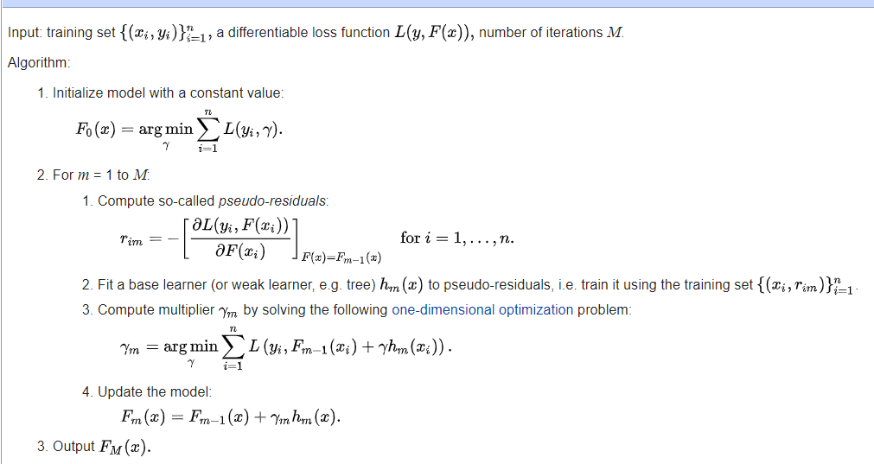
from sklearn.ensemble import GradientBoostingRegressor import numpy as np import pandas as pd from sklearn.model_selection import train_test_split from sklearn.metrics import mean_squared_error from sklearn.datasets import load_boston from sklearn.metrics import mean_absolute_error
boston = load_boston() X = pd.DataFrame(boston.data, columns=boston.feature_names) y = pd.Series(boston.target)
X_train, X_test, y_train, y_test = train_test_split(X, y)
regressor = GradientBoostingRegressor( max_depth=2, n_estimators=3, learning_rate=1.0 )regressor.fit(X_train, y_train)
How it works?
Step 1: Calculate the average of the target label
Step 2: Calculate the residuals
Step 3: Construct a decision tree
Step 4: Predict the target label using all of the trees within the ensemble
Step 5: Compute the new residuals
Step 6: Repeat steps 3 to 5 until the number of iterations matches the number specified by the hyperparameter (i.e. number of estimators)
Step 7: Once trained, use all of the trees in the ensemble to make a final prediction as to the value of the target variable

Slide 8
Real time problems.
In this study, we analyze two mobile phone activity datasets to predict the future traffic of mobile base stations in urban areas. The predicted time series can be used to reflect the trend of human activity flow. Although common methods such as recurrent neural network and long short-term memory (LSTM) network often achieve a high precision, they have the short back of time-consuming. So, we present the improved gradient-boosted decision tree algorithm based on Kalman filter (GBDT-KF) due to the noise in the original time series, because the decrease in the performance of GBDT is usually caused by overfitting the noise in the signal. According to our experiments, although the RMSE of the predicted values of our GBDT-KF and the ground truth is only 12–14% worse than that of the LSTM model, the proposed GBDT-KF algorithm makes a trade-off between the precision and time complexity and achieves over 100-time training time reduction compared with the LSTM model. By implementing the result of our work, service providers could predict where and when a network congestion would happen; therefore, they could take actions ahead of time. Such applications are useful especially in the era of 5G.

Slide 9
Genetic algorithm
In Computer science and Operation research, a genetic algorithm (GA) is a metaheuristic inspired by the process of neural selection that belongs to the larger class of evolutionary algorithm(EA). Genetic algorithms are commonly used to generate high-quality solutions to optimization and search problem by relying on biologically inspired operators such as mutation, crossover, selection
a pair of "parent" solutions is selected for breeding from the pool selected previously. By producing a "child" solution using the above methods of crossover and mutation, a new solution is created which typically shares many of the characteristics of its "parents". New parents are selected for each new child, and the process continues until a new population of solutions of appropriate size is generated. Although reproduction methods that are based on the use of two parents are more "biology inspired", some research^{[4][5]} suggests that more than two "parents" generate higher quality chromosomes.
These processes ultimately result in the next generation population of chromosomes that is different from the initial generation. Generally the average fitness will have increased by this procedure for the population, since only the best organisms from the first generation are selected for breeding, along with a small proportion of less fit solutions. These less fit solutions ensure genetic diversity within the genetic pool of the parents and therefore ensure the genetic diversity of the subsequent generation of children.
Opinion is divided over the importance of crossover versus mutation. There are many references in Foglel (2006) that support the importance of mutation-based search.
Although crossover and mutation are known as the main genetic operators, it is possible to use other operators such as regrouping, colonization-extinction, or migration in genetic algorithms.It is worth tuning parameters such as the mutation probability, crossover probability and population size to find reasonable settings for the problem class being worked on. A very small mutation rate may lead to genetic drift. A recombination rate that is too high may lead to premature convergence of the genetic algorithm. A mutation rate that is too high may lead to loss of good solutions, unless elitist selection is employed. An adequate population size ensures sufficient genetic diversity for the problem at hand, but can lead to a waste of computational resources if set to a value larger than required.

Slide 10
References
https://towardsdatascience.com/machine-learning-part-18-boosting-algorithms-gradient-boosting-in-python-ef5ae6965be4
https://sefiks.com/2018/10/04/a-step-by-step-gradient-boosting-decision-tree-example/
https://en.wikipedia.org/wiki/Gradient_boosting
https://en.wikipedia.org/wiki/Genetic_algorithm
https://www.simplilearn.com/10-algorithms-machine-learning-engineers-need-to-know-article

Slide 11
THANK YOU

